Slide 1


Slide 2
Agenda
batch processing
Streaming processing vs batch processing
Dstreams
Streaming Transformations
Streaming Actions
Flume with spark streaming
Kafka introduction
Topics
Producer and consumers in kafka
Spark kafka streaming

Slide 3
Batch Processing:
In batch processing data is collected, processed, and results are produced in batches.
So far we have seen the use cases, where we have huge data and we need insight on those data.
Batch processing is very efficient in processing high value of data, and we leveraged Spark to achieve parallelizing this batch processing.
We have learnt many of the SPARK concepts to work on massive data at hand.
There are more ways in which we could encounter data in real world scenario.

Slide 4
Streaming:
Many big data application receive data in real time.
These applications must act on data in real-time rather than look at data latter (what we have been used to do in Hadoop and Spark so far).
For these application data is valuable at its time of arrival.
We are going to see about this new class of big data application called Distributed Stream Processing.
There is no dearth of buzz words in the world where we need to encounter data in a continuous fashion.
Distributed Complex Event Processing.
Distributed Event Stream Processing.

Slide 5
Streaming:
Broadly stream processing falls into two categories, they are:
CEP (Complex Event Processing) is a state-full event processing system used in places where multiple event occurrence might co-relate so some activity
ESP (Event Stream Processing) falls into stateless event processing used in jobs like continuous ETL transformation, trending topics in social media, etc,.
Stream processing involves continuous input and outcome of data. The emphasis is more on the velocity of the data.
Data must be processed within small time frame or near real time.
Stream processing gives decision makers the ability to adjust contingencies based on events and trends developing in real-time.

Slide 6
Streaming:
The world as we know works by pulling data from a datasource, analyses it,
generated output.
All that we know about this is going to change

Slide 7
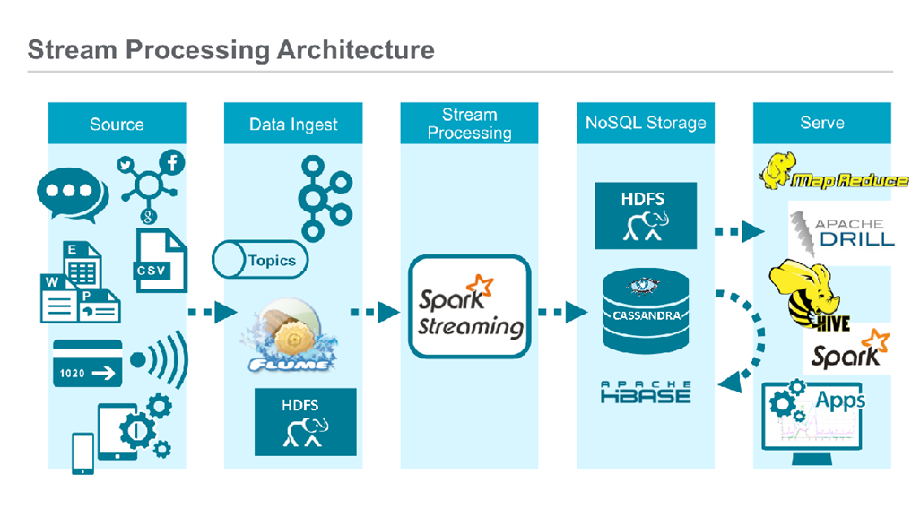

Slide 8
Streaming:
We are going to see new set of systems in which data is pushed to a system that must evaluate queries in response to a detected event.
Example
IoT
Location tracking
Sensor
Telemetry
Social Media

Slide 9
Streaming:
In a distributed stream processing, an incoming data is acted upon immediately and information / action is pushed onto the user to take some decisions.
Basically it inverted the access pattern we have been used so far.
Usually user looks into data, processing it by running few queries, and takes
some decisions.
With stream processing, every incoming data is analyzed and could potentially issues the user a notification to take action without user explicitly asking for.

Slide 10
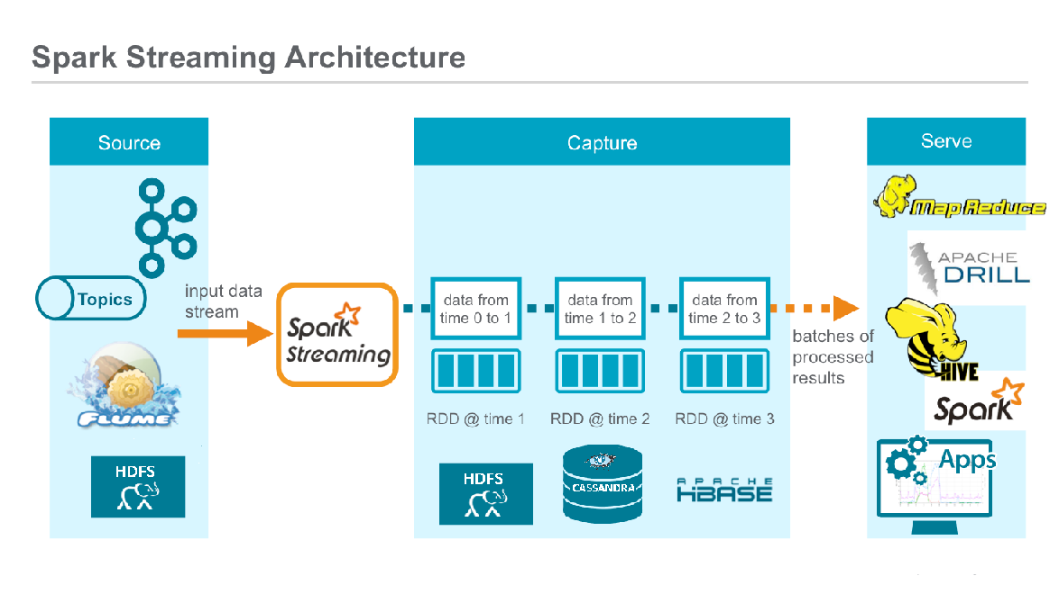

Slide 11
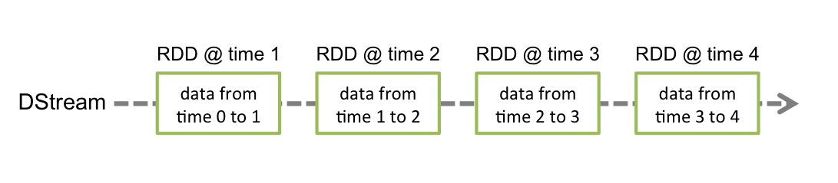
Dstream
Discretized Stream or DStream is the basic abstraction provided by Spark Streaming. It represents a continuous stream of data, either the input data stream received from source, or the processed data stream generated by transforming the input stream. Internally, a DStream is represented by a continuous series of RDDs, which is Spark’s abstraction of an immutable,

Slide 12
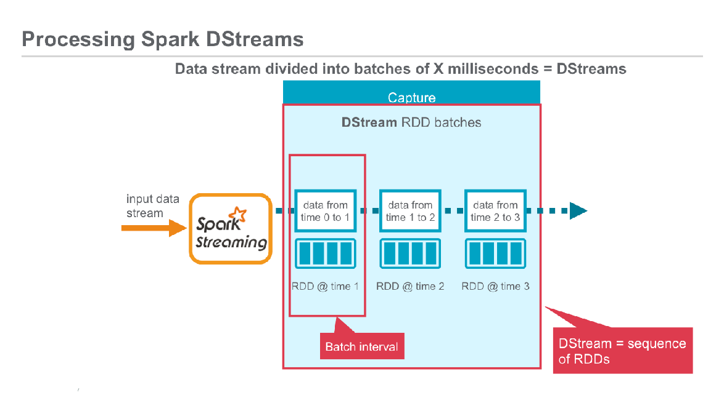

Slide 13
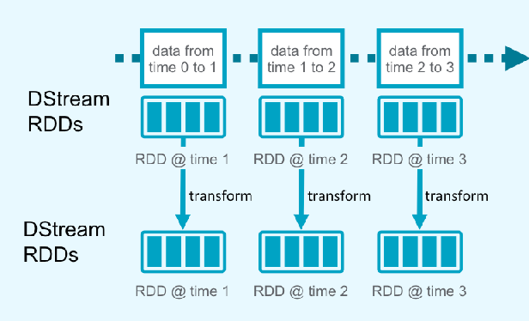
Processing Spark Dstreams

Slide 14
Spark StreamingContext
Entry point to all streaming functionality
You can create streaming Context from
Existing SparkContext
import org.apache.spark.streaming.{StreamingContext,Seconds}
val ssc = new StreamingContext(sc,Secongd(5))
Existing SparkConf
val ssc = new SparkContext(conf,Seconds(5))

Slide 15
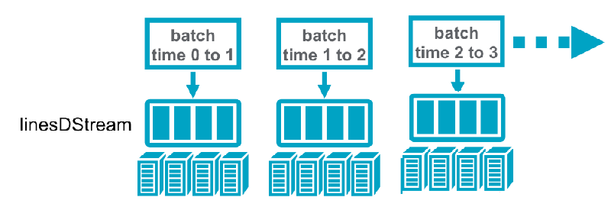
How to Create Dstream
val ssc = new SparkContext(sparkConf,Seconds(5))
val lineDstream = ssc.textFileStream(“/user/cloudera/streaming”)
Batch Interval
Dstream :A sequence of RDD’s
representing a stream of data
Stored in Memmory
as RDD

Slide 16
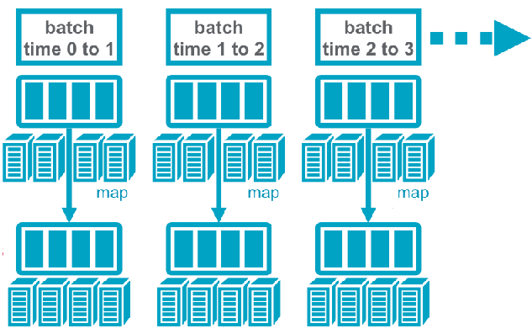
Process Dstream
case class Emp(id:Int,name:String,sal:Double)
def empParser(line:String):Emp={
var data = line.split(“,”)
Emp(data(0).toInt,data(1),data(2).toDouble)
}
lineDstream.foreachRDD(rdd => rdd.map(empParser).foreach(println))
lineDstream RDD’s
New RDD created for every batch
EmpDstream RDD’s

Slide 17
A simple stream processing coding..

Slide 18
We will look into a network word count, that is, say we are monitoring chat session of a user and want to create a count of each words.

Slide 19
Stream Processing Coding:
Create a folder called SparkStreamBasic.
Create a file called build.sbt and copy the below contents:
name := "SparkStreamBasic"
version := "1.0"
scalaVersion := "2.10.5"
organization := "in.goai"
libraryDependencies += "org.apache.spark" %% "spark-core" % "1.6.1"
libraryDependencies += "org.apache.spark" %% "spark-sql" % "1.6.1"
libraryDependencies += "org.apache.spark" % "spark-streaming_2.10" % "1.6.1"
resolvers += Resolver.mavenLocal

Slide 20
Stream Processing Coding:
Create the folder project and create a file called build. properties and copy the below content:
sbt.version = 0.13.11
Create the folder hierarchy and change to the directory goai:
src/main/scala/in/goai/
Create this file using a text editor:
SparkStreamBasic.scala
Copy this code into SparkStreamBasic.scala

Slide 21
Stream Processing Coding:
package in.goai
import org.apache.spark.storage.StorageLevel
import org.apache.spark.streaming.{Seconds, StreamingContext}
import org.apache.spark.{SparkConf, SparkContext}
import org.apache.spark.rdd.RDD
import org.apache.log4j.{Level, Logger}
import org.apache.spark.Logging
object SparkStreamBasic {
def main(args: Array[String]) {
if (args.length < 2) {
System.err.println("Usage: NetworkWordCount <hostname> <port>")
System.exit(1)
}
InternalLogging.setStreamingLogLevels()
// Create the context with a 1 second batch size
val sparkConf = new SparkConf().setAppName("NetworkWordCount")
val ssc = new StreamingContext(sparkConf, Seconds(1))
val lines = ssc.socketTextStream(args(0), args(1).toInt, StorageLevel.MEMORY_AND_DISK_SER)
val words = lines.flatMap(_.split(" "))
val wordCounts = words.map(x => (x, 1)).reduceByKey(_ + _)
wordCounts.print()
ssc.start()
ssc.awaitTermination()
}
}

Slide 22
Stream Processing Coding:
To Compile
sbt package
To Run
Open two terminals
In terminal 1 do the following:
nc -lk 9999
In terminal 2 do the following:
$SPARK_HOME/bin/spark-submit --master "local[*]" --class in.goai.SparkStreamBasic target/scala-2.10/sparkstreambasic_2.10-1.0.jar
In terminal 1 start typing some text and press enter.
In terminal 2 you will start seeing results.

Slide 23
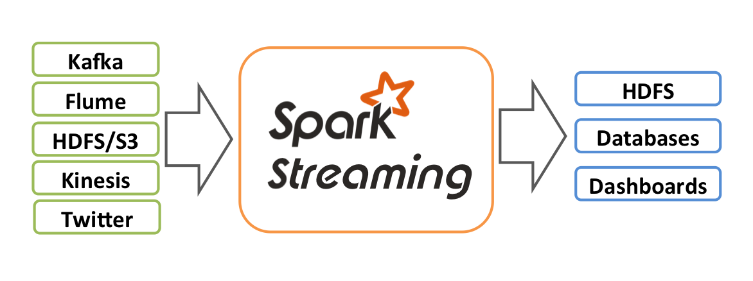
Key Concepts
DataSources:
File Based source : HDFS
Network Bases : TCP Sockets
Twitter,Kafka,Flume,ZeroMQ

Slide 24
Streaming Transformations
Transfomrations : like RDD transoframtions , will create new Dstream respective map function.
Standard RDD Operations :
map, countByValue,reduce,join ….
Stateful Operations :
countByValueAndWindow,reduceByKeyAndWindow..

Slide 25
Streaming Actions
Output operations : trigger computations
print : print first 10 elements
saveAsObjectFile,saveAsTextFile,saceAsHadoopFiles – save to HDFS
foreachRDD – do anything with each batch of RDDs
Note : you must call any of actions before starting your streaming application ,
If not the application wont start and throw not output operations found exception
Notes:
Audio:
Thank you for attending the course.

Slide 26


Flume Spark Streaming

Slide 27
Flume – Spark Traffic Streaming
Flume Configuration To get the Traffic Data
agent2.sources = httpsource
agent2.sinks = sparksink
agent2.channels = memchannel
agent2.sources.httpsource.type = exec
agent2.sources.httpsource.command = sh /home/cloudera/trafficdata.sh
agent2.sources.httpsource.restart = true
agent2.sinks.sparksink.type = org.apache.spark.streaming.flume.sink.SparkSink
agent2.sinks.sparksink.hostname = 10.1.7.9
agent2.sinks.sparksink.port = 6666
agent2.channels.memchannel.type = memory
agent2.sources.httpsource.channels = memchannel
agent2.sinks.sparksink.channel = memchannel
trafficdata.sh
curl "http://api.openweathermap.org/data/2.5/forecast?id=1269843&APPID=10762cb77421440db021f3f46b458328"

Slide 28
Traffic Data Parsing
val data = FlumeUtils.createPollingStream(ssc,"10.1.7.9",6666,StorageLevel.MEMORY_ONLY)
.map(x => x.event)
.map(x => new String(x.getBody.array()))
data.foreachRDD{ rdd =>
val records = rdd.flatMap{ line =>
val gson = new Gson();
val data1 = gson.fromJson(line,classOf[java.util.HashMap[String,java.util.ArrayList[java.util.Map[String,String]]]])
data1.get("incidents").toList.map(x => gson.toJson(x))
}
val trafficData = sqlContext.read.json(records)
if(trafficData.count>0)
trafficData.show
trafficData.registerTempTable("traffic")
sqlContext.sql("select count(*) from traffic").show
}

Slide 29
Kafka Streaming
Whats is Kafka ?
Apache Kafka is an open-source stream processing platform developed by the Apache Software Foundation written in Scala and Java
Kafka aims to provide a unified, high-throughput, low-latency platform for handling real-time data feeds.

Slide 30
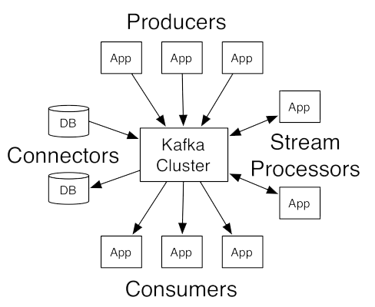
Kafka Overview
LinkedIn (www.linkedin.com): Apache Kafka is used at LinkedIn for the streaming of activity data and operational metrics. This data powers various products such as LinkedIn news feed and LinkedIn Today in addition
to offline analytics systems such as Hadoop.
Twitter (www.twitter.com/): Twitter uses Kafka as a part of its Storm— a stream-processing infrastructure.

Slide 31
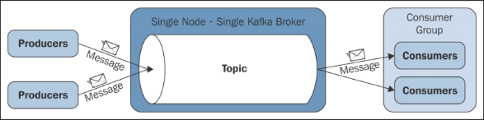
Kafka design fundamentals
In a very basic structure, a producer publishes messages to a Kafka topic, which is created on a Kafka broker acting as a Kafka server. Consumers then subscribe to the Kafka topic to get the messages. This is described in the following diagram:
Producers publish data to the topics of their choice. The producer is responsible for choosing which record to assign to which partition within the topic.
Consumers label themselves with a consumer group name, and each record published to a topic is delivered to one consumer instance within each subscribing consumer group

Slide 32
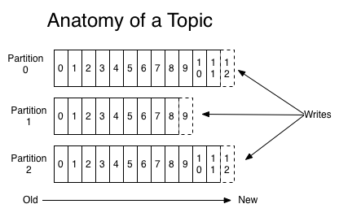
Topics and Logs
A topic is a category or feed name to which records are published. Topics in Kafka are always multi-subscriber; that is, a topic can have zero, one, or many consumers that subscribe to the data written to it.
For each topic, the Kafka cluster maintains a partitioned log that looks like this:

Slide 33
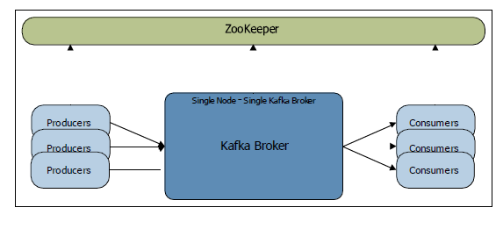
Single node – single broker cluster

Slide 34
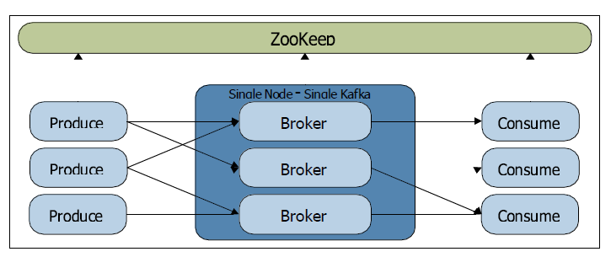
Single node – multiple broker cluster

Slide 35
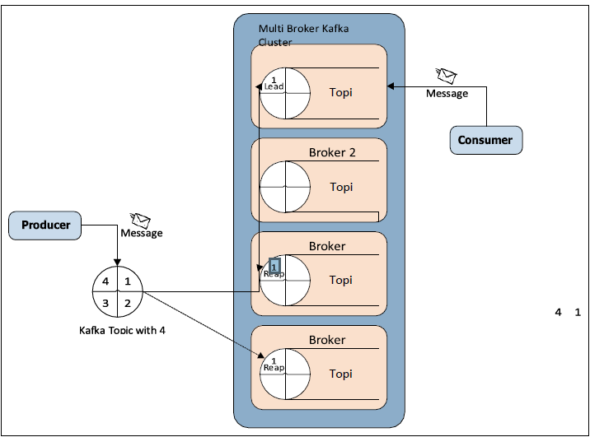
Replication in Kafka

Slide 36

Kafka Spark Streaming

Slide 37


Flume – Kafka Configuration
tier1.sources = source1
tier1.channels = channel1
tier1.sinks = sink1
tier1.sources.source1.type = exec
tier1.sources.source1.command = sh /home/cloudera/weathersource.sh
tier1.sources.httpsource.restart = true
tier1.sources.source1.channels = channel1
tier1.channels.channel1.type = memory
tier1.channels.channel1.capacity = 10000
tier1.channels.channel1.transactionCapacity = 1000
tier1.sinks.sink1.type = org.apache.flume.sink.kafka.KafkaSink
tier1.sinks.sink1.topic = kafkaTest
tier1.sinks.sink1.brokerList = localhost:9092
tier1.sinks.sink1.channel = channel1
tier1.sinks.sink1.batchSize = 20
weathersource.sh
curl "http://api.openweathermap.org/data/2.5/forecast?id=1269843&APPID=10762cb77421440db021f3f46b458328"

Slide 38
Parsing Kafka Data
val (zkQuorum, group, topics, numThreads) = ("10.1.7.9:2181", "kelly", "kafkaTest", "2")
val stream = KafkaUtils.createStream(ssc, zkQuorum, group, topicMap).map(_._2)
stream.foreachRDD{
rdd =>
val records = rdd.flatMap{
line =>
val gson = new Gson();
val data1 = gson.fromJson(line,classOf[java.util.HashMap[String,java.util.ArrayList[java.util.Map[String,String]]]])
data1.get("list").toList.map(x => gson.toJson(x))
}
val weatherData = sqlContext.read.json(records)
if(weatherData.count>0)
weatherData.show
weatherData.registerTempTable("weather")
sqlContext.sql("select count(*) from weather").show
}

Slide 39
Summary
• Spark Streaming is an extension of the core Spark API that enables scalable, high-throughput, fault-tolerant stream processing of live data streams.
• Data can be ingested from many sources like Kafka, Flume, Kinesis, or TCP sockets, and can be processed using complex algorithms expressed with high-level functions like map, reduce, join and window.
• Spark Streaming receives live input data streams and divides the data into batches, which are then processed by the Spark engine to generate the final stream of results in batches.
• Spark Streaming provides a high-level abstraction called discretized stream or DStream, which represents a continuous stream of data.
• DStreams can be created either from input data streams from sources such as Kafka, Flume, and Kinesis, or by applying high-level operations on other DStreams. Internally, a DStream is represented as a sequence of RDDs.

Slide 40
QUIZ
What is the difference between RDD and Dstream
What is a microbatch
What is the role of zookeeper in kafka architecture
Can we have multiple consumers for a single kafka topic
How to configure spark sink in flume
Spark streaming is pure realtime stream processing (Yes/No)

Slide 41
MCQ
1. ______________ leverages Spark Core’s fast scheduling capability to perform streaming analytics.
a) MLlib
b) Spark Streaming
c) GraphX
d) RDDs
Ans:Spark streaming
2. In Spark Streaming the data can be from what all sources?
a)Kafka
b)Flume
c)Kinesis
d)All of the above
Ans: All of the above

Slide 42
MCQ
3. The basic abstraction of Spark Streaming is
a)Dstream
b)RDD
c)shared variable
d)Accumulators
4. Dstream internally is
a) Continuous Stream of RDD
b) Continuous Stream of DataFrame
c) Continuous Stream of DataSet
d) None of the above

Slide 43
Handson
https://drive.google.com/drive/u/0/folders/1m1aeGUpER4bCGx2HFT6PChltRxe3pKTA

